Slide 1

touchdevelop a mobile IDE in the cloud
Michał Moskal, Nikolai Tillmann, Peli de Halleux, Tom Ball, Sebastian Burckhardt, Manuel Fähndrich*
Microsoft Research
PEPM Workshop
San Diego, January 20, 2014

Slide 2
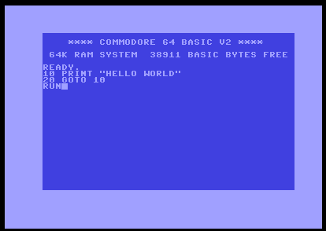
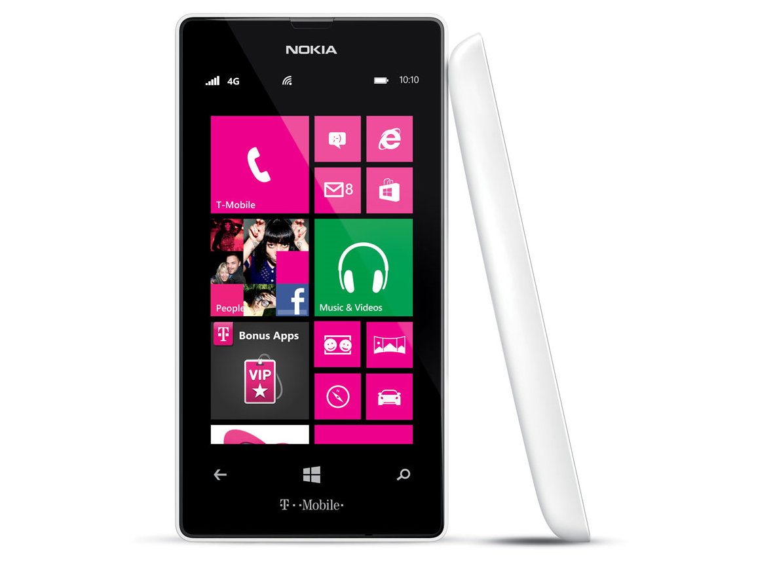
first, most personal, and sometimes only computing device
can you really program on such a tiny screen?
Notes:
touchdevelop:
bringing the joy of programming from early computers to modern touch devices

Slide 3
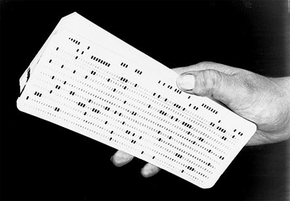
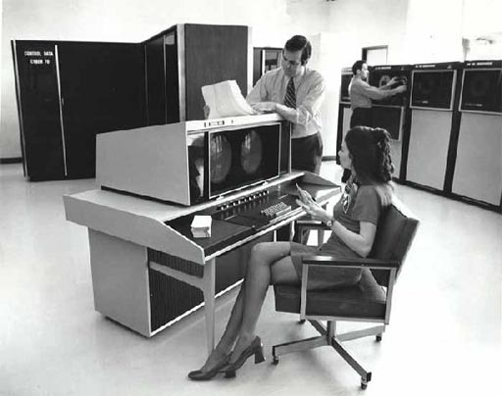
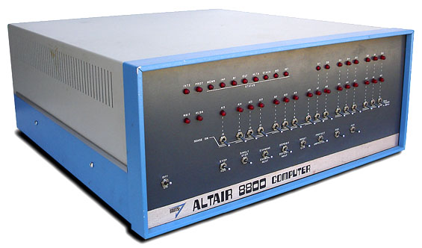

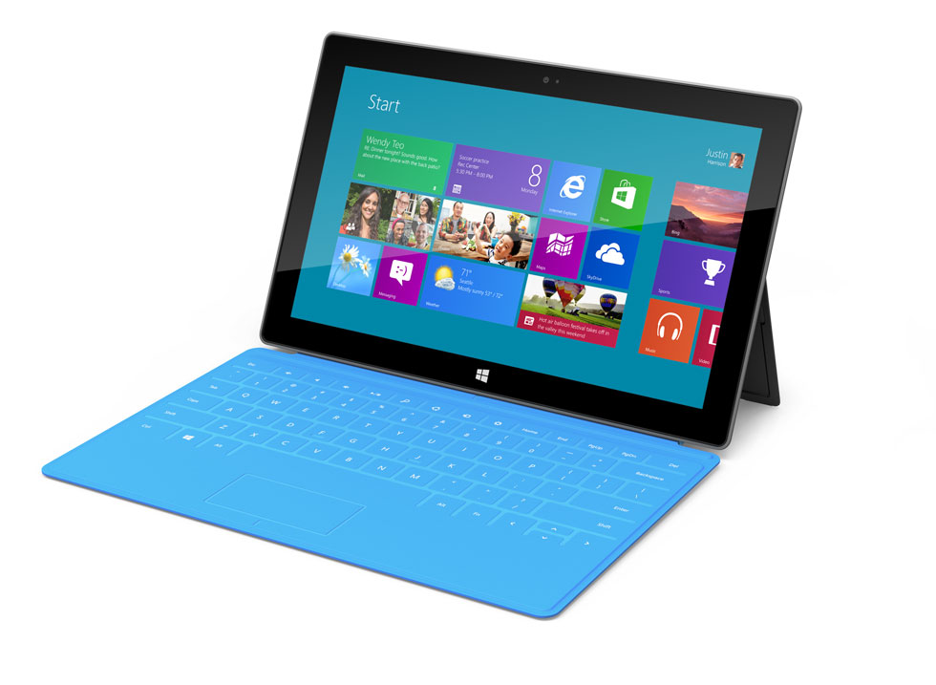
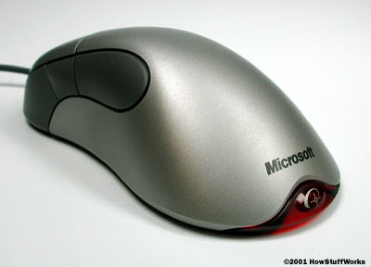
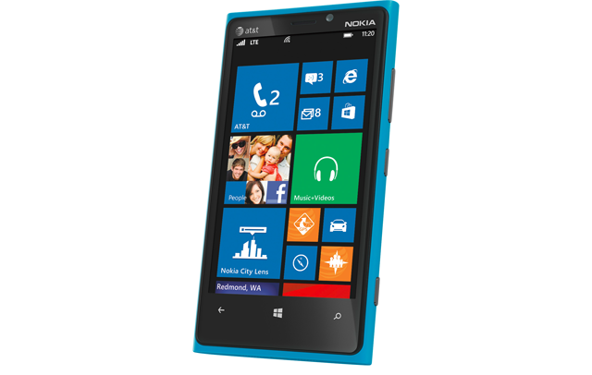
interfaces having always been changing
?

Slide 4
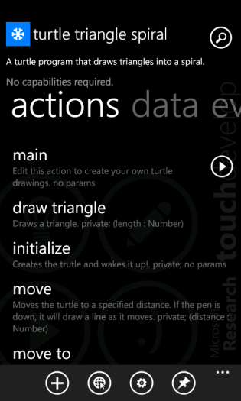
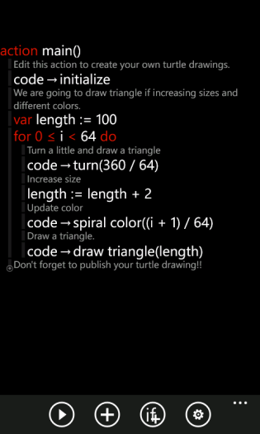
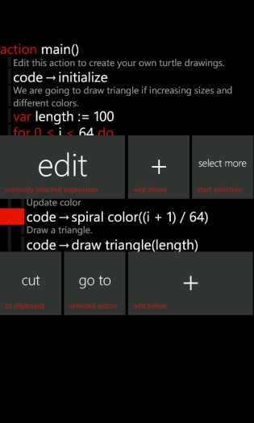
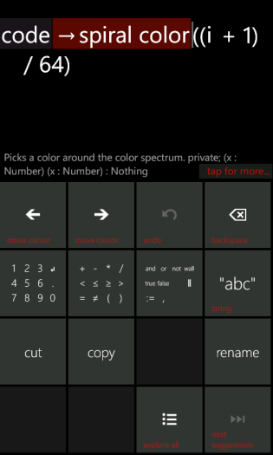
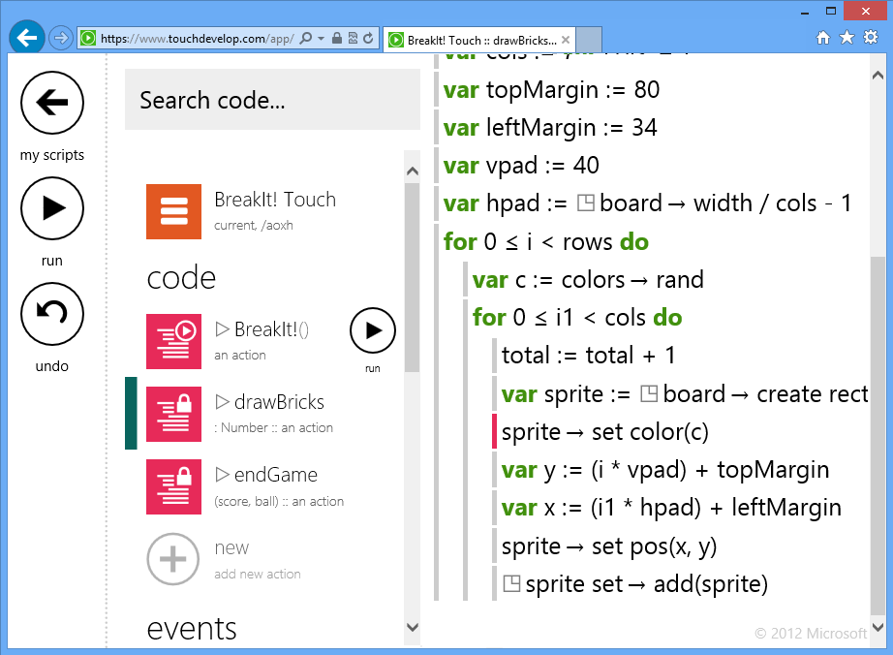
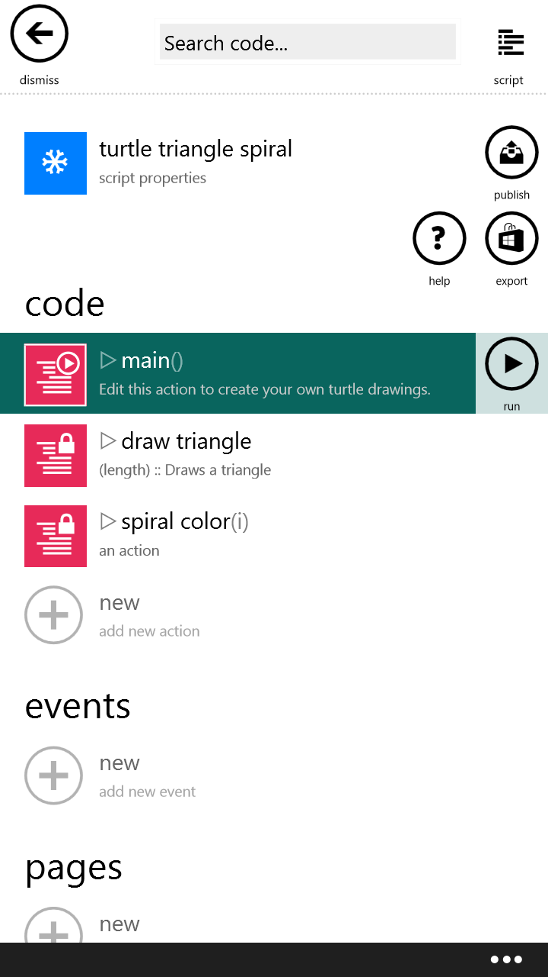
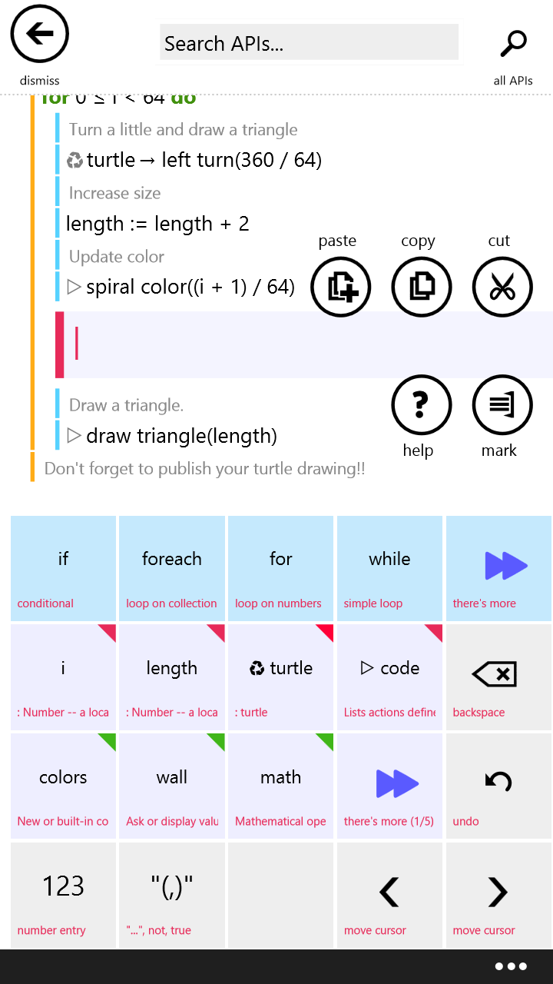
touchdevelop: a touch-first IDE
Windows Phone app (2011)
web app (2012)
iOS, Android,
Windows Phone
Windows, Mac, Linux
Notes:
Fridges running Android

Slide 5
touchdevelop
demo
core editing
touchdevelop.com
Notes:
Expr vs stmt, statically typed language
Copy&paste, some refactorings: extract to local, simplify, extract to parameter, promote to global/field, demote to local, extract action, extract to library, surround with …
On the phone it’s more exciting – pictures, songs, accelerometer, compass, etc

Slide 6
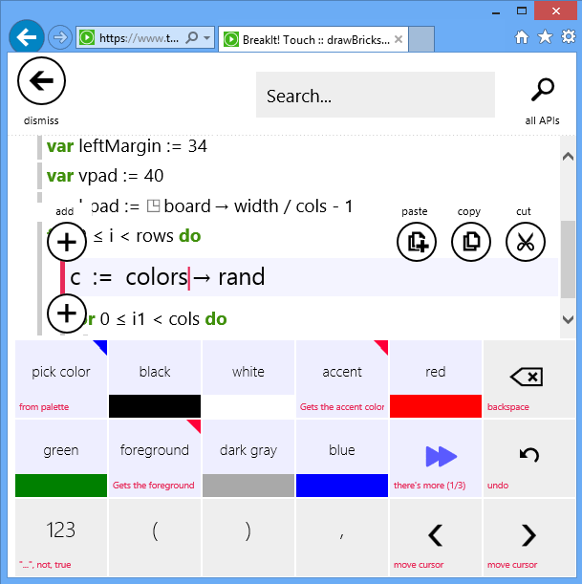
language + editor
typed language + semi-structured editor
typed, imperative, procedural, data-structures, lambda expressions, module system
expressions edited as token sequences
auto-completion by crowd-sourcing
high-level abstractions

Slide 7

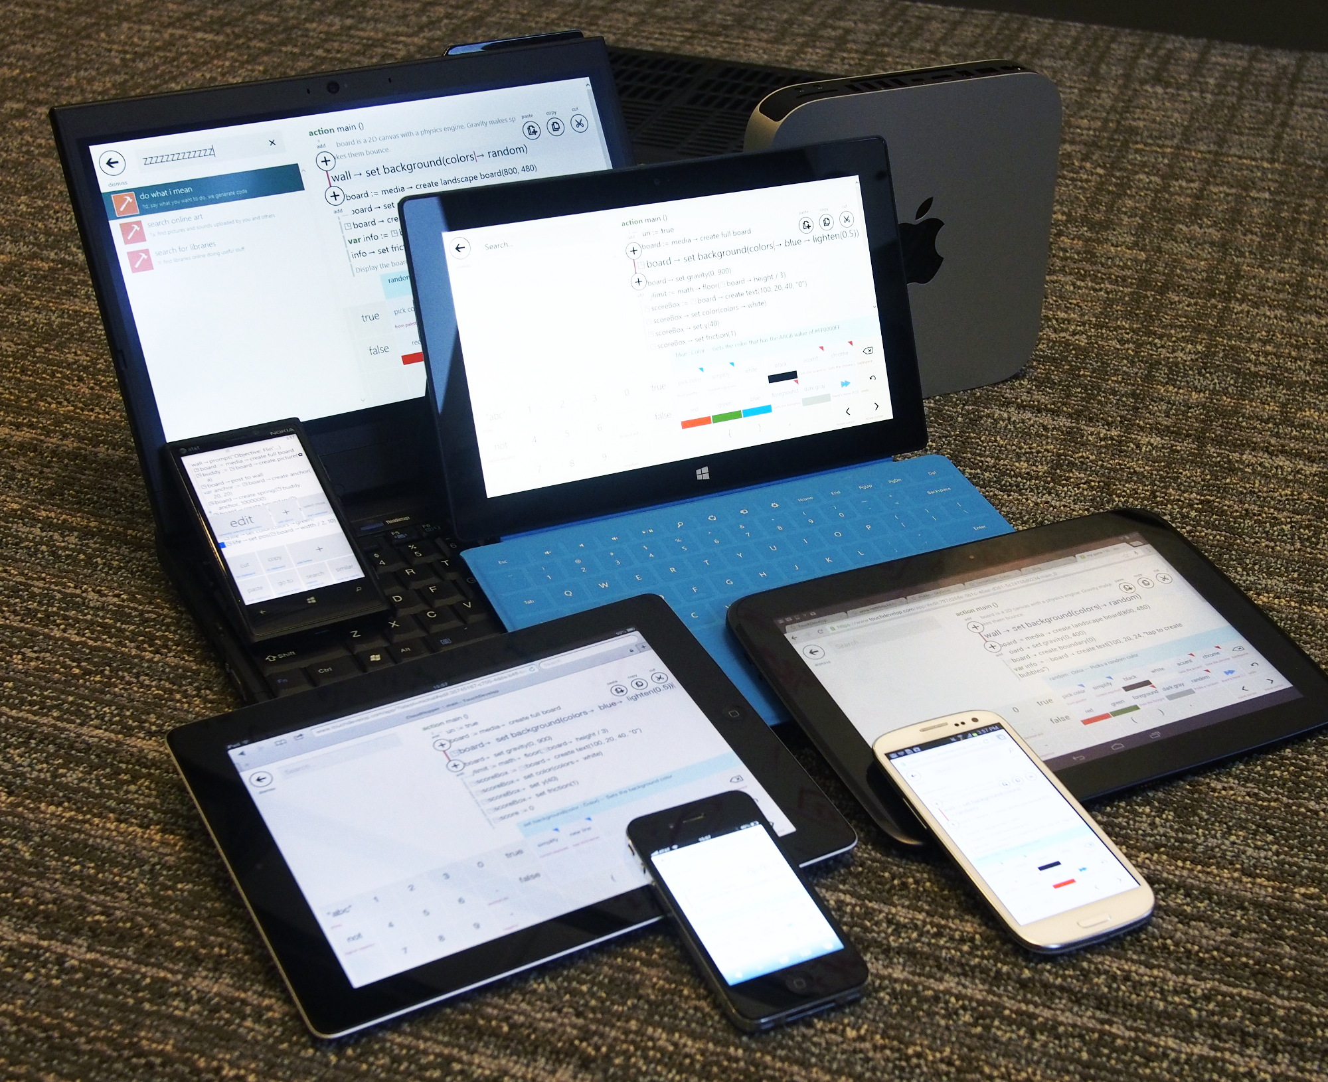

mission: democratize programming
touchdevelop: BASIC for all devices and the web
(or Bourne Shell, AppleScript, VBA, Excel Macros, …)

Slide 8
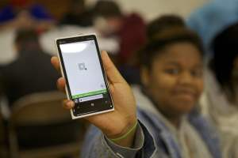
who are our users
app-creators to be
students & teachers
enthusiasts
developers who want to prototype
goal: anyone with a computing device
Notes:
Enthusiasts: Peter Helden’s My Online Meetings, Lego

Slide 9
touchdevelop
demo
publishing, hub
crowd-sourced crashes, coverage, profiles
Electronic Constructor, Rex, Buddy and the Bones
touchdevelop.com
Notes:
Hub: electronic ctor, rex – wrapping web services, REST, libraries, live editing,
Buddy – first crash bucket – shake before start

Slide 10
future of programming: devices+cloud+social
Devices: phones, tablets, laptops, desktops, ...
Works on all devices, keyboard or not -> editing ASTs
Easy access to on-device media and sensors
Scripts synchronized across all your devices
Cloud-powered: platform and user scripts
Crowd-sourced crash logging, profiling, coverage collection
Cloud data and (soon) execution
Plugins in the cloud
Social: user-generated content
Scripts, libraries – come with source for tweaking
Comments, likes, tags, followers, ...
Pictures and sounds – searchable
Scripts as docs (especially libraries), tutorials (teaching)

Slide 11
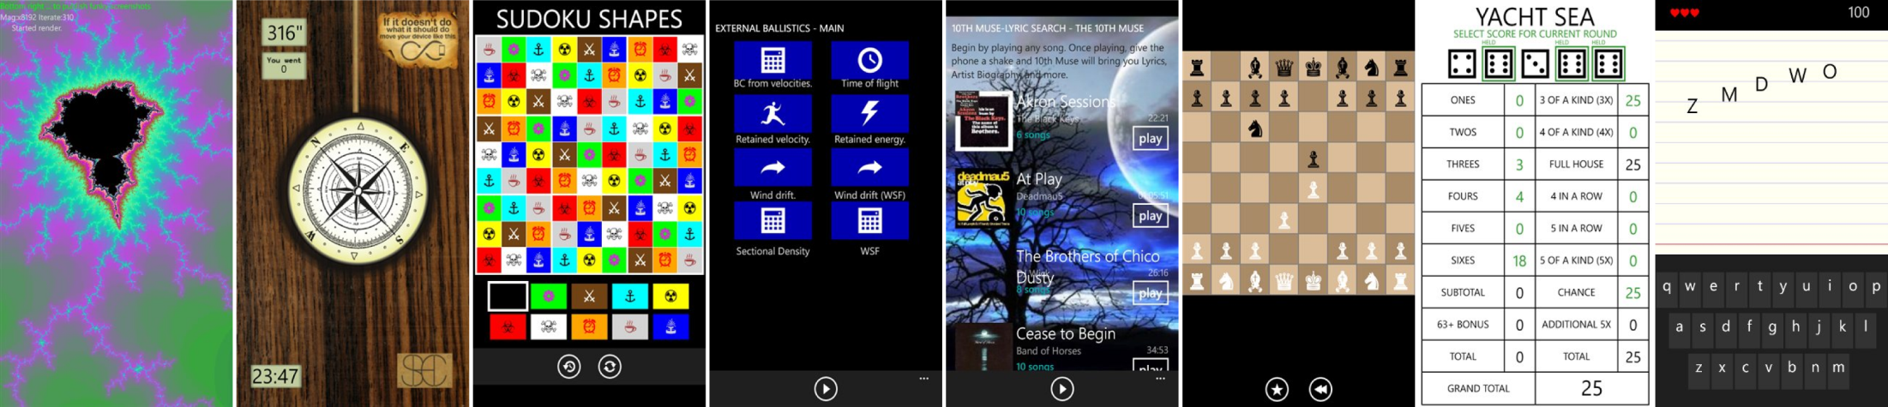
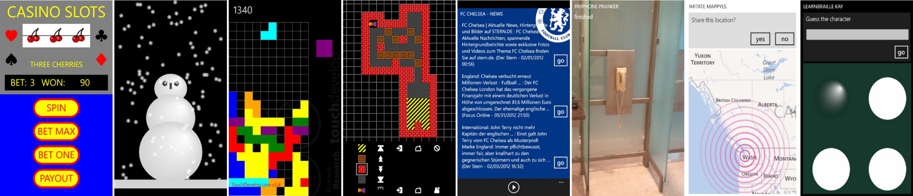
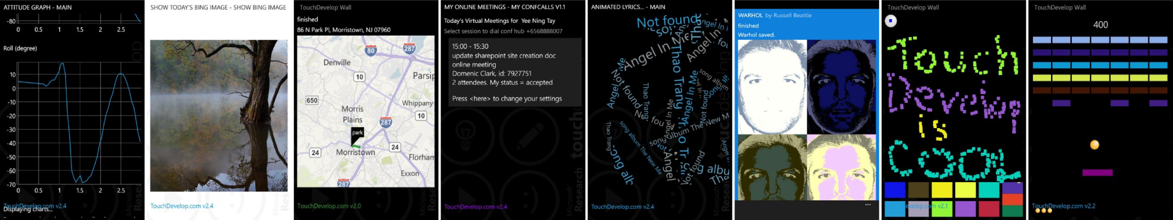
touchdevelop.com
400,000+ app downloads
160,000+ registered users
70,000+ published scripts
700+ apps in stores

Slide 12
abstract syntax
script ::= meta-info decl* decl ::= action | page | event | global | library | record action ::= private? sync? action sig stmt* event ::= event sig stmt* page ::= private? page sig init stmt* display stmt* sig ::= id (id : type)* returns (id : type)* global ::= var id : type flag* record ::= cloud? (object | table | index | decorator) keys (id : type)* values (id : type)* stmt ::= expr | // comment | if expr then stmt* else stmt* | loop do stmt* | boxed stmt* loop ::= while expr | for id < expr | for each id in expr expr ::= token* (where sig stmt*)* token ::= “...” | true | false | 0 | 1 | ... | ( | ) | , | + | * | ... | async | id | → id

Slide 13
touchdevelop
demo
Manipulating TouchDevelop programs with TouchDevelop
touchdevelop.com
Notes:
Lint, C++ export, JSON schema generator, decamelizer, localizer, regex explorer, claudifier, many more possible!

Slide 14
opportunity: data mining
REST-based service APIs at http://touchdevelop.com/api/...
lists | properties
/api/scripts /api/users /api/comments /api/screenshots /api/reviews /api/tags /api/art ... | /api/[id] /api/[scriptid]/text /api/[scriptid]/ast /api/[scriptid]/successors /api/[scriptid]/base /api/[userid]/scripts /api/[scriptid]/comments /api/[scriptid]/screenshots /api/[scriptid]/reviews /api/[userid]/picture …
touchdevelop.com/help/cloudservices
Notes:
+history

Slide 15
high-velocity research platform
IDE powered by the cloud
data mining: 1,000+ active user every day, 3,000,000+ program snapshots
social features (sharing, attribution, discussions, …)
information-flow analysis to deal with privacy concerns
crowd-sourced profiling, code coverage, crash reporting
ranking of code by novelty
live programming
cloud-based code synthesis from keywords
cloud state
coming soon: collaborative coding, adaptive tutorials, cloud execution, “apps”, …
Notes:
We are not just doing this for fun. There is research behind it.
We are ahead of the crowd.
We need to do it to have the data!
An applied research language!
We are very excited about the research opportunities, but…

Slide 16

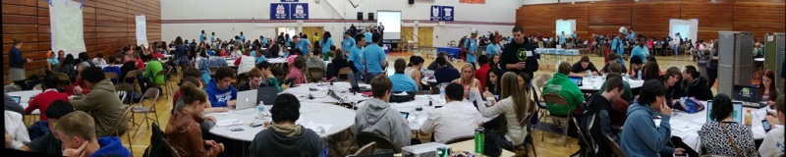
touchdevelop + education
1st App Day in May 2013, 500+ students. Many follow-up events, and 1500 students planned this year.
130,000+ students doing TouchDevelop tutorials in Hour of Code.

Slide 17
touchdevelop
demo
Interactive tutorials based on AST diff
touchdevelop.com

Slide 18
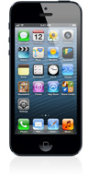
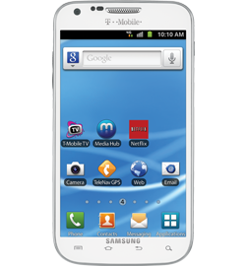
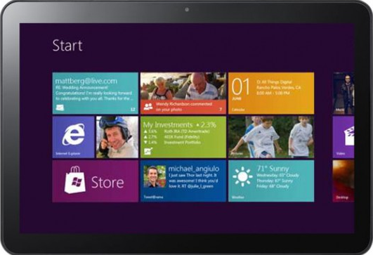
cloud state
sharing data in the cloud makes apps more social, fun, and convenient.
examples: games, settings, chat, favorites, ratings, comments, grocery list…
just tag your data as ‘cloud’, we synchronize and merge
cloud state

Slide 19


coming soon: mobile cloud computing
putting parts of scripts in the cloud makes mobile apps more efficient and enriches functionality
supporting non-blocking execution using distributed state
just tag your code as
‘cloud’, we do the rest…
cloud
execution

Slide 20
touchdevelop
demo
Cloud chat
touchdevelop.com

Slide 21
touchdevelop
questions?
try it yourself: touchdevelop.com

Slide 22
touchdevelop
backup slides
building touchdevelop

Slide 23

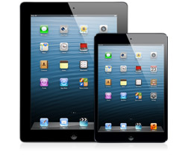


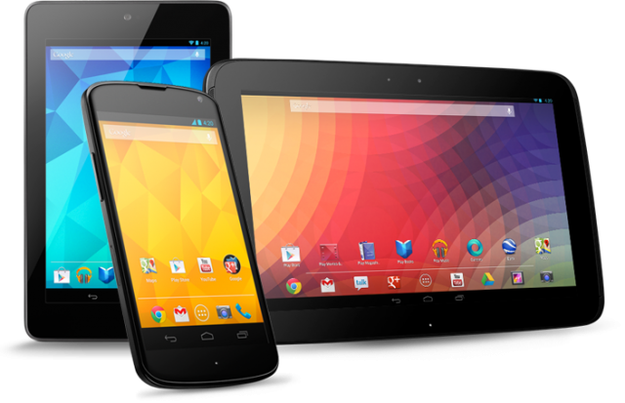
architecture
touchdevelop.com
.ts
RGB
0 24 143
RGB
0 188 242
RGB
0 216 204
RGB
127 186 0
RGB
186 216 10
RGB
255 175 0
RGB
255 140 0
RGB
232 17 35
RGB
244 114 208
RGB
155 79 150
Notes:
[dev hat]
Cloud stuff we can reuse, just need to change the protocol a bit.
The core experience of TD is editing code, there’s more though. This is why I was the one starting JS rewrite – I was responsible lang/editor on the phone since the beginning. Others did libraries, intelli sense, social etc.

Slide 24
the scale of things
152,000 lines of C#
12,000 lines of XAML
.js
60,000 lines of TypeScript
4,000 lines of CSS
130,000 lines of C#
(plus 10,000 lines of tools in C#)
RGB
0 24 143
RGB
0 188 242
RGB
0 216 204
RGB
127 186 0
RGB
186 216 10
RGB
255 175 0
RGB
255 140 0
RGB
232 17 35
RGB
244 114 208
RGB
155 79 150
Notes:
[dev hat]
Cloud stuff we can reuse, just need to change the protocol a bit.
The core experience of TD is editing code, there’s more though. This is why I was the one starting JS rewrite – I was responsible lang/editor on the phone since the beginning. Others did libraries, intelli sense, social etc.

Slide 25
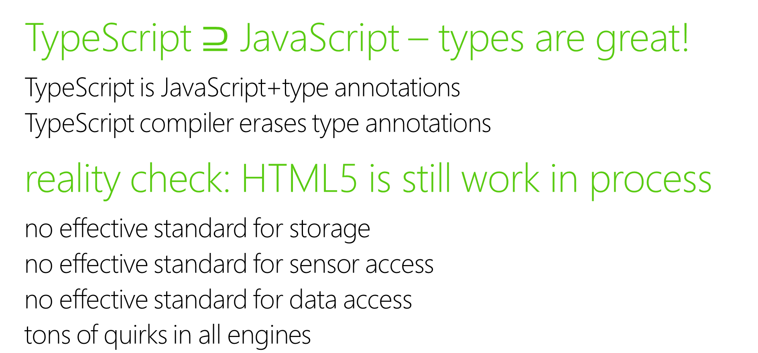
reflections after building web app
TypeScript $⊇$ JavaScript – types are great!
TypeScript is JavaScript+type annotations
TypeScript compiler erases type annotations
reality check: HTML5 is still work in process
no effective standard for storage
no effective standard for sensor access
no effective standard for data access
tons of quirks in all engines
touchdevelop.com/help/platforms

Slide 26
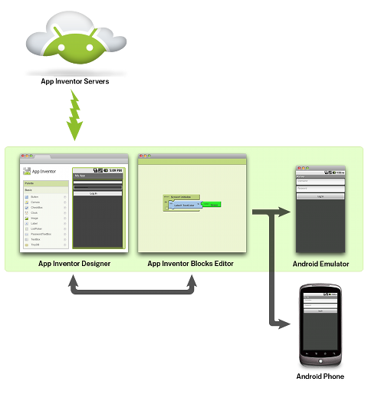
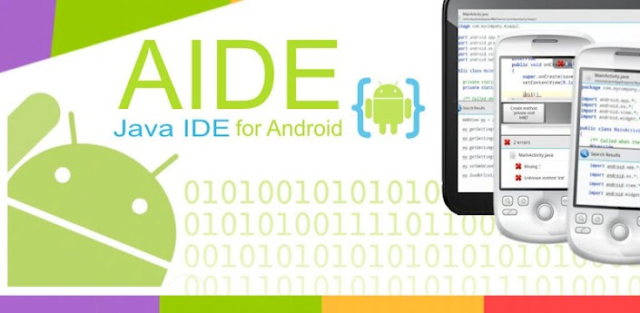
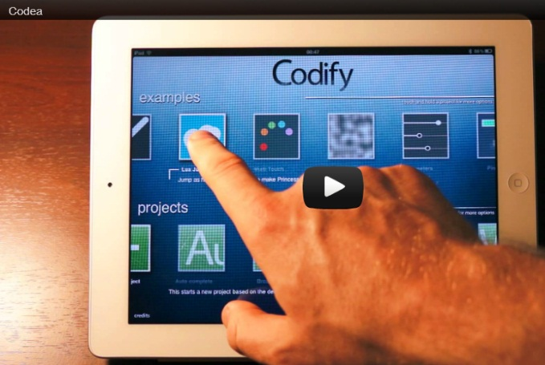
related approaches: mobile IDEs
PC – legacy development model
Android: AIDE, App Inventor, …
iOS: Codea
mobile development environments are becoming popular on all platforms
only touchdevelop embraces new devices (touchscreen, editor, language, social)

Slide 27
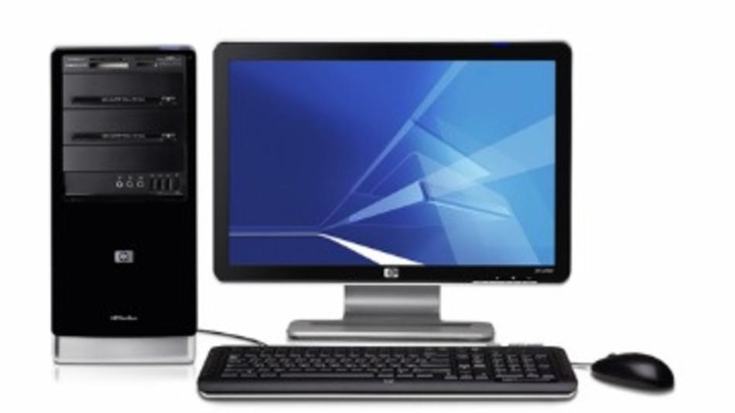
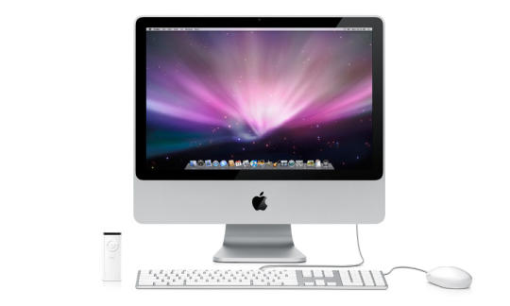
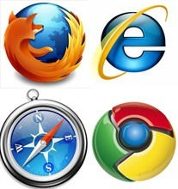
code + run scripts on all devices

Slide 28
highlights
Structured/token split editing
TD plugins in TD operating on ASTs
Lint, C++ export, JSON schema generator, decamelizer, localizer, regex explorer, claudifier, many more possible!
Multiple refactorings
extract to local, simplify, extract to parameter, promote to global/field, demote to local, extract action, extract to library, surround with …
Wealth of data in the cloud
Language research platform
Tutorial – diff

Slide 29
TouchDevelop (www.touchdevelop.com) is…
a simple statically-typed safe programming language
a browser-based programming environment
a set of high-level APIs for sensors, data, services, …
a cloud of programmers, scripts, users, data, bugs, …

Slide 30
why do we care?
computing devices everywhere
smartphones, tablets – mobile, touchscreens
cloud-connected (intermittent)
social communities, crowd-sourcing
education
Notes:
Dramatic changes
MSR has agility

